Slide 1
Feature Engineering
Outlier Handling

Slide 2
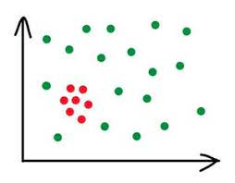
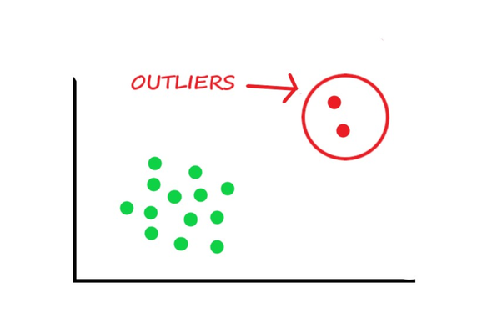
What is Outlier?
Outlier is a data object that deviates significantly from the rest of the data objects and behaves in a different manner.

Slide 3
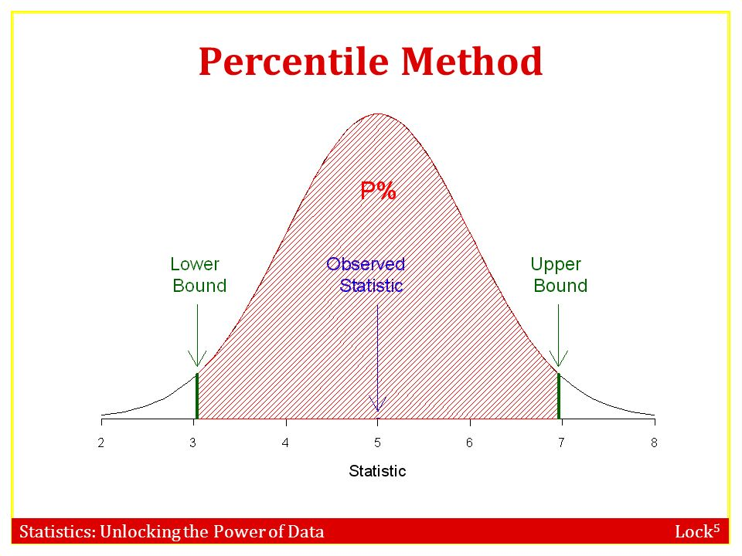
How to Remove Outliers ?
Using Percentile Technique

Slide 4
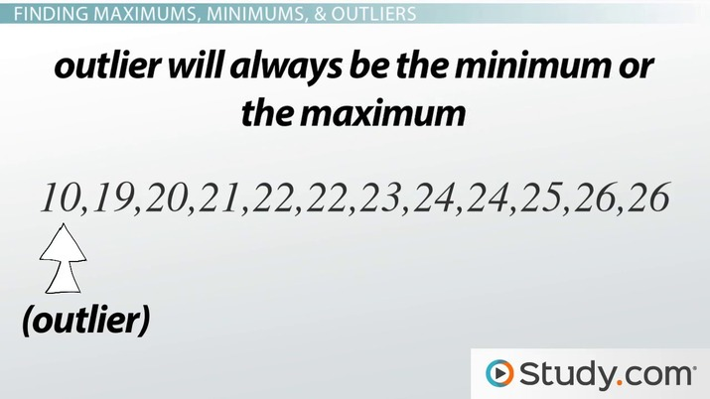
Feature Engineering

Slide 5
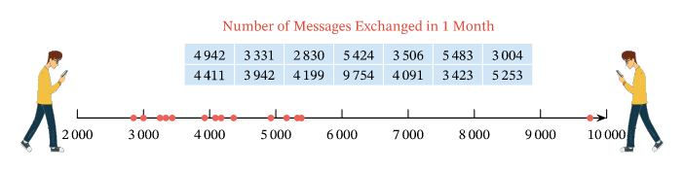

Slide 6
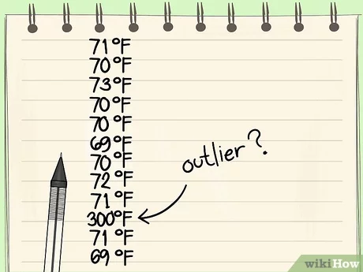

Slide 7
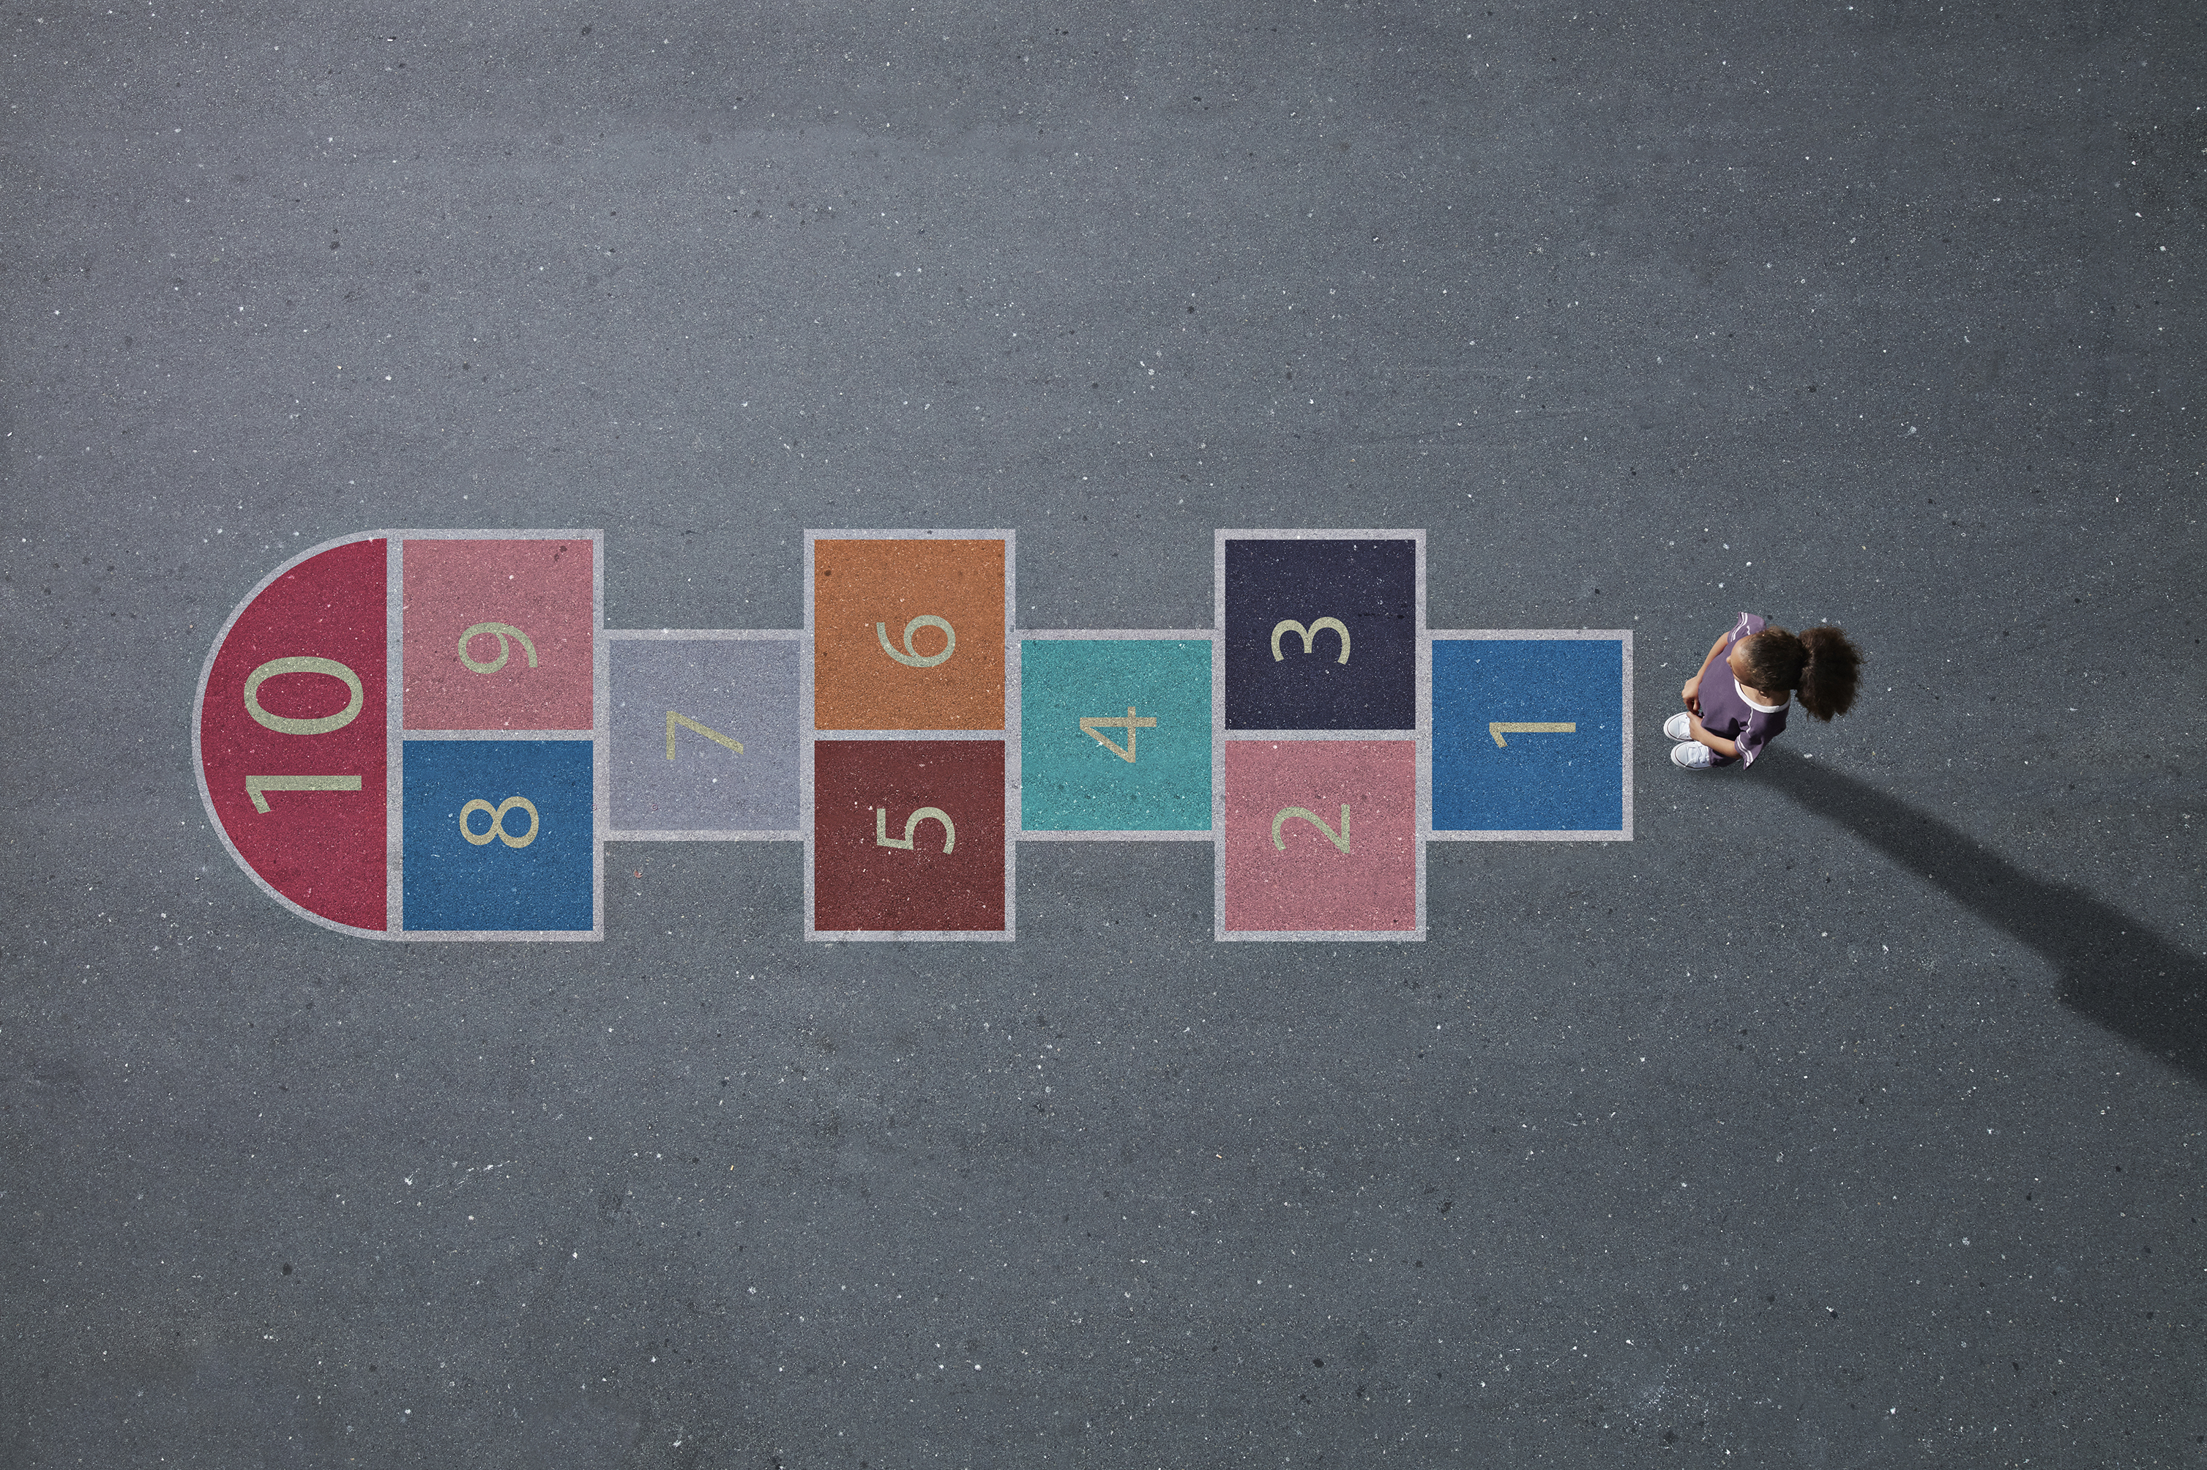
Outlier Handling Using Z-Score
Z-score tells how many standard deviations away a given observation is from the mean

Slide 8
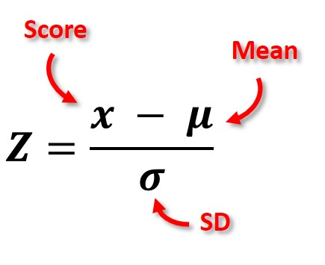

Slide 9
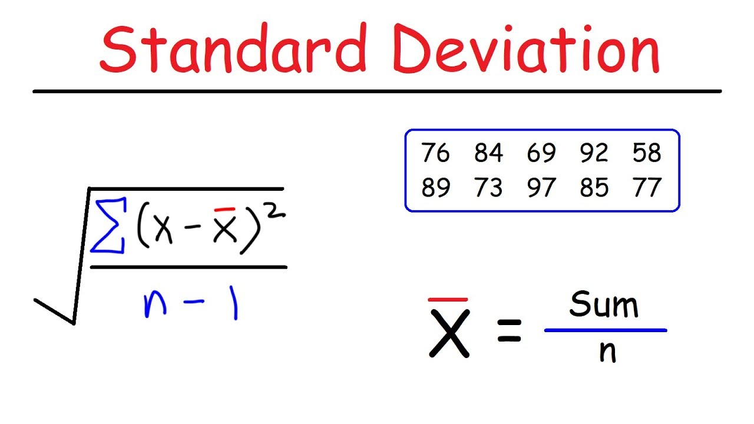

Slide 10
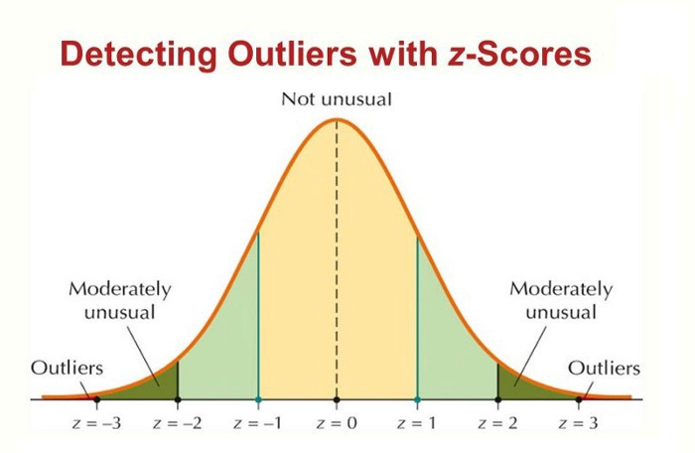

Slide 11

Any z-score greater than +3 or less than -3 is considered as outlier which is pretty much similar to standard deviation method.

Slide 12
Let’s Code

